Slide 1

Budget surfing
CSCI 5308
Prof: Tushar Sharma
Client Team: Group 24
Dev Team Group 18:
Hardee Rameshchandra (B00869195)
Neelansh Gulati (B00892946)
Parth Dhirubhai Gondaliya (B00893694)
Guturu Rama Mohan Vishnu (B00871849)
Tuan Hamid (B00877065)

Slide 2

What is the project all about?
There are some platforms to organize and manage travel plans (such as Hopper, WorldMate, MakeMyTrip) via managing hotel booking, flight itineraries, tracking the status of your flights, and rental car reservations.
But those platforms have some limitations such as no track of travel expenses, expensive food stays and hotels, not knowing how to save and spend money etc.
This website will cover those limitations. Additionally, it can track the travel expenses of a traveler and set a budget for him to spend on, it can find a place to stay with the locals on the trip and also keep a record of expense you share with your travel partners.

Slide 3

Meeting Stats
Total number of meetings with client team only: 7
2 with TA and 5 without TA
Total number of meetings with dev team only : 6
Total internal meetings of our team: 10
2 with TA and 8 without TA

Slide 4
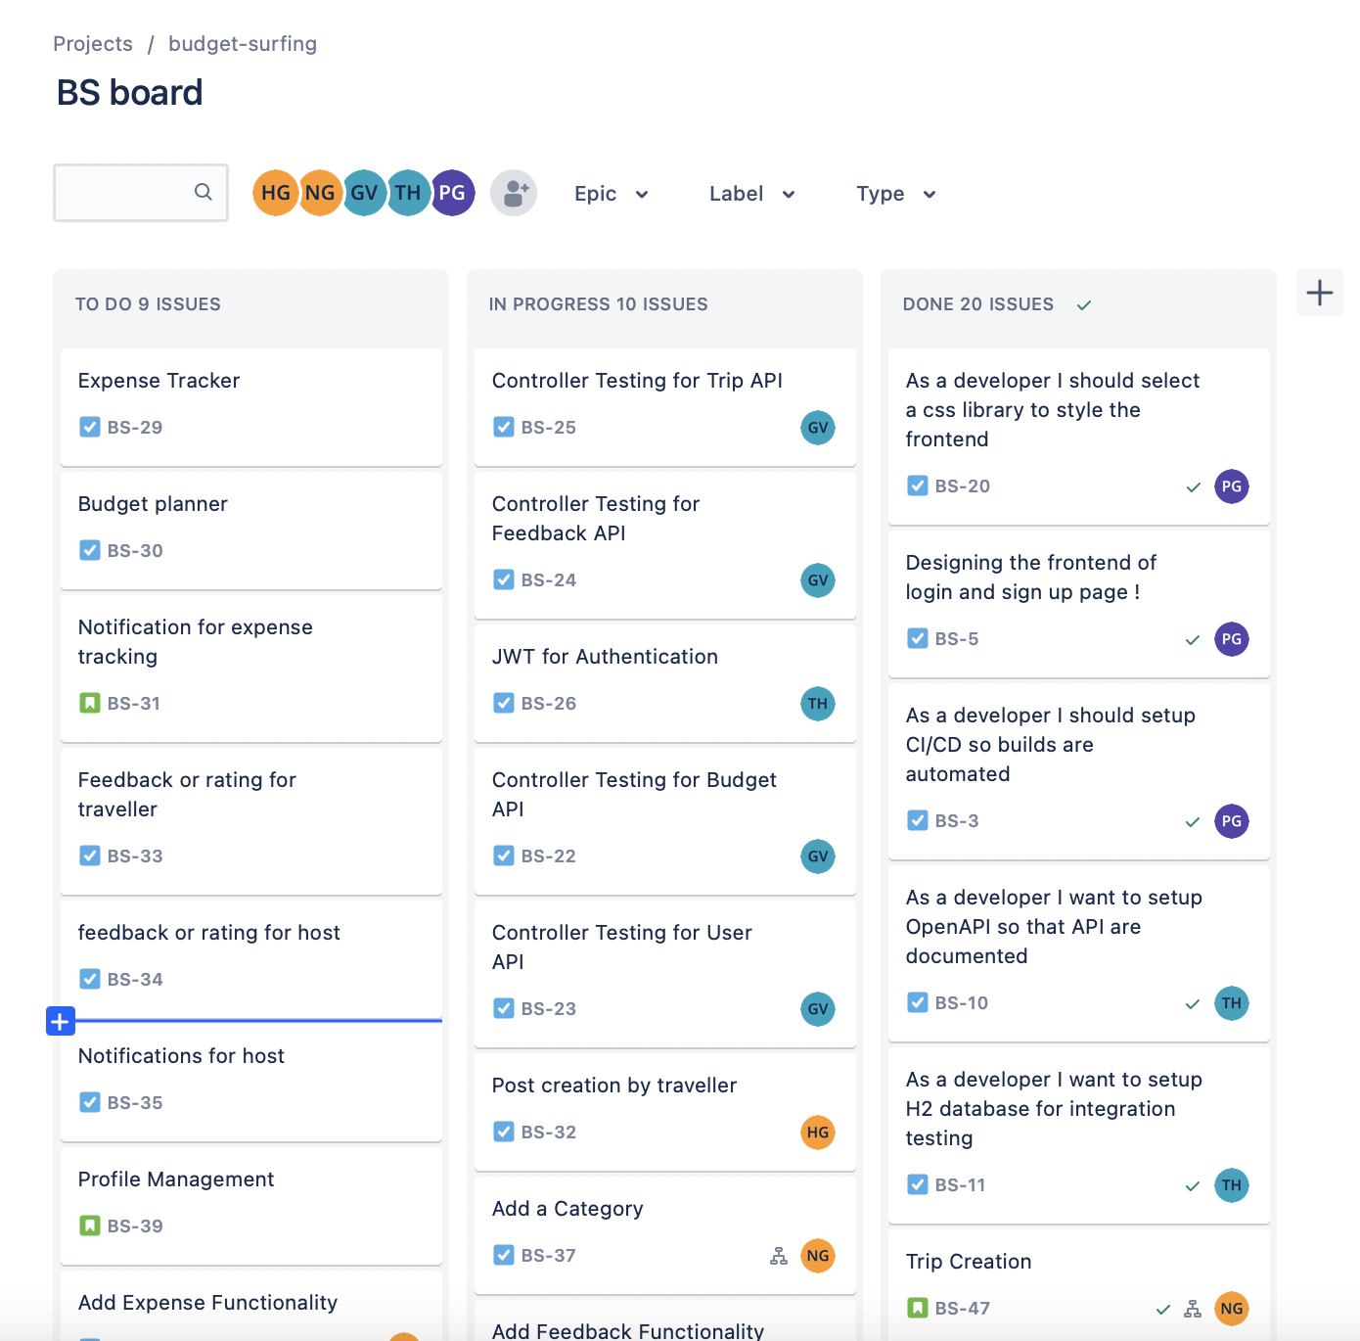
JIRA Board Progress: As a team

Slide 5
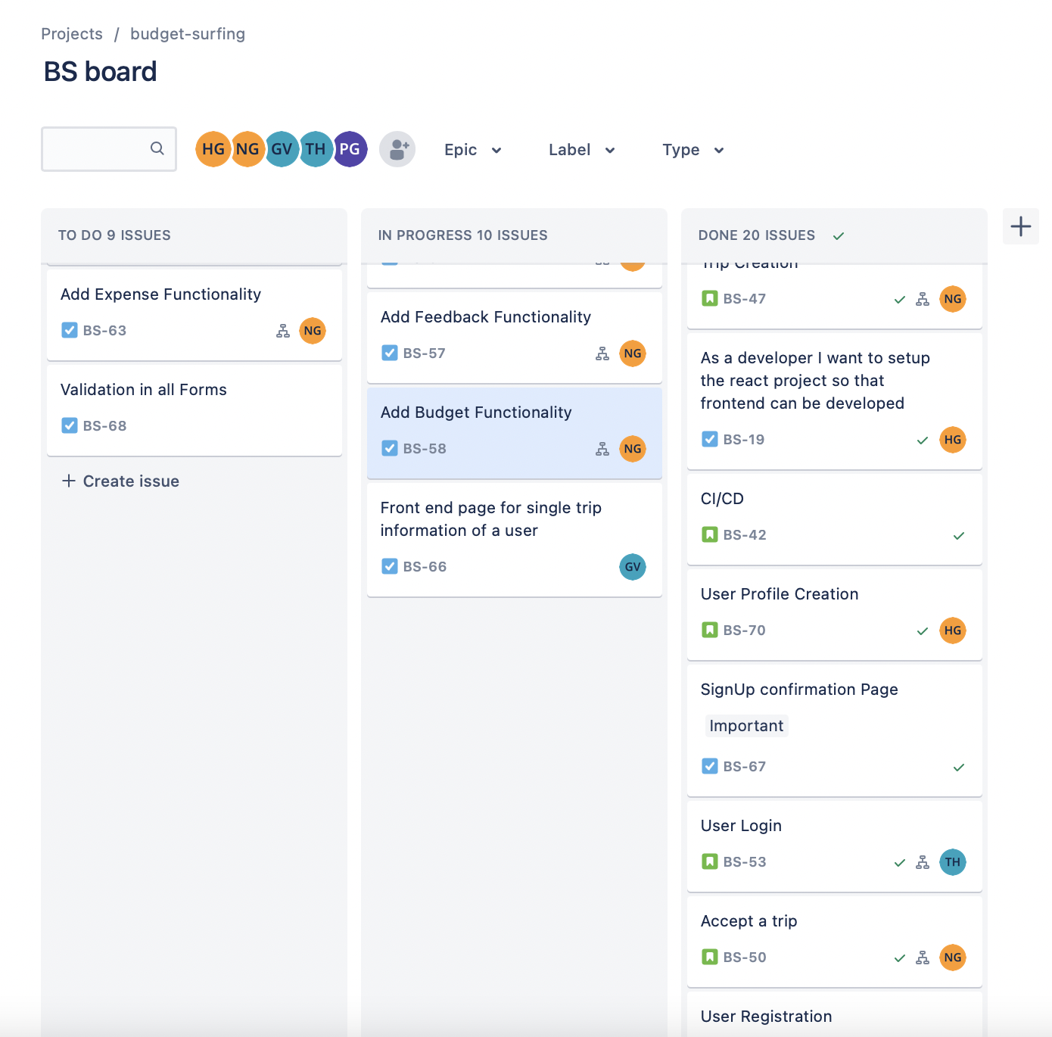
JIRA Board Progress: As a team continue…

Slide 6
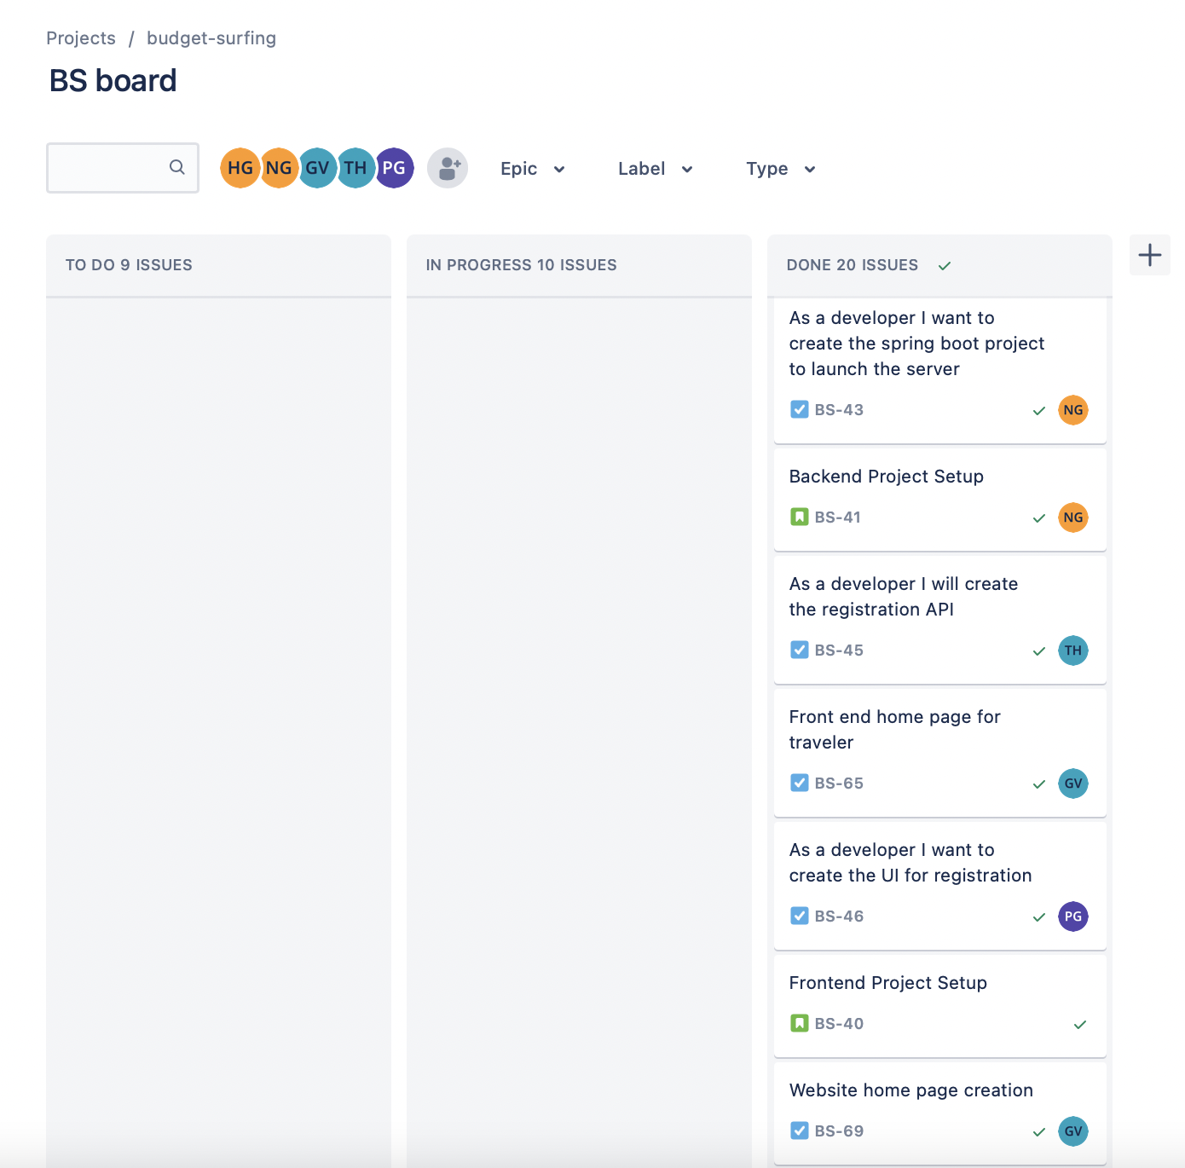
JIRA Board Progress: As a team continue…

Slide 7
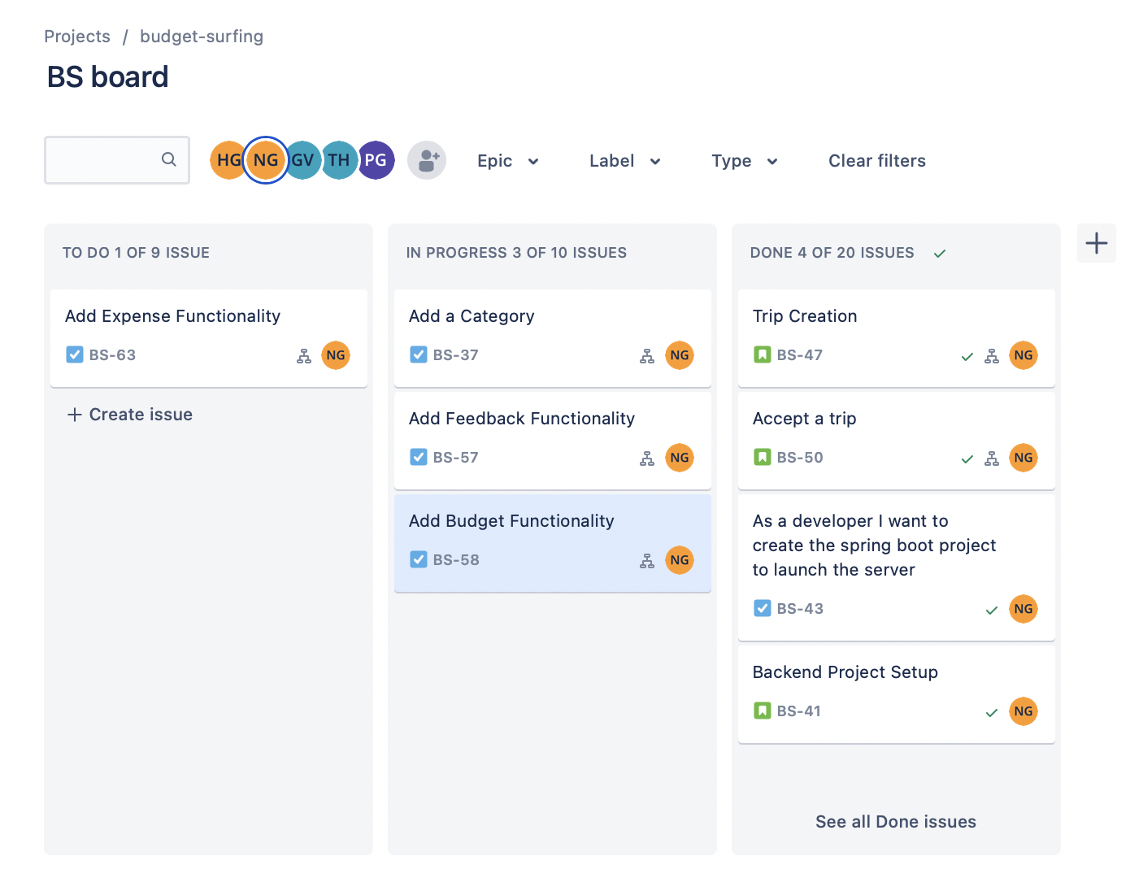
JIRA Board Progress: Neelansh Gulati (B00892946)

Slide 8
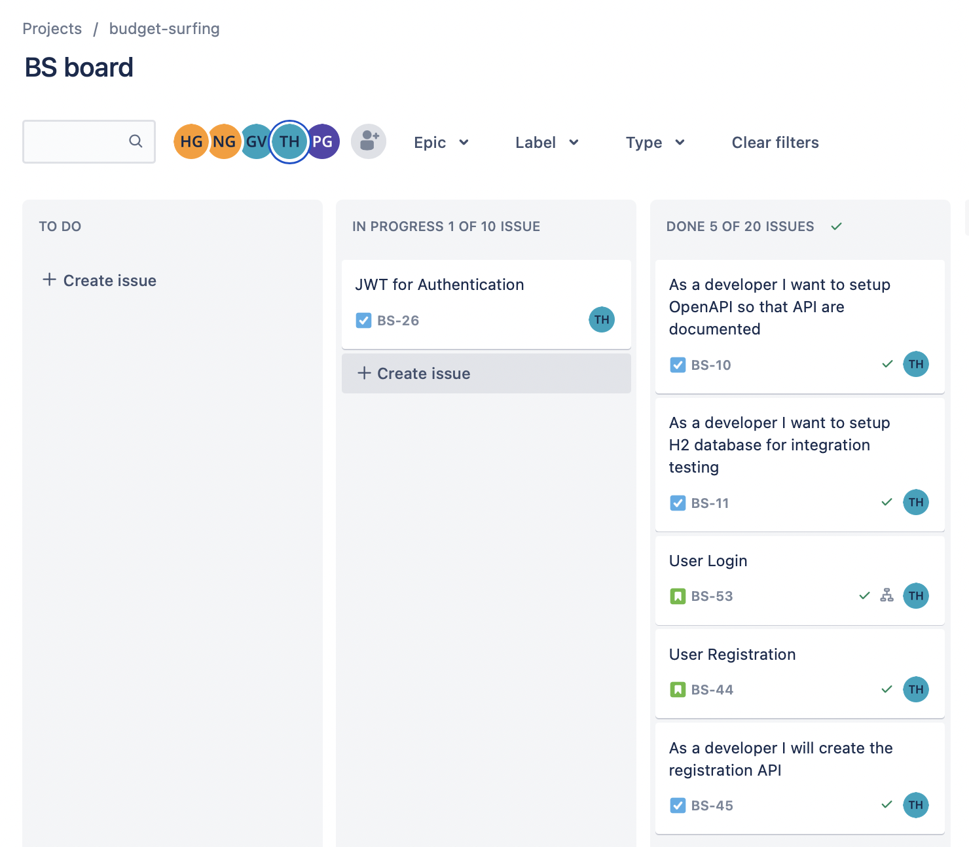
JIRA Board Progress: Tuan Hamid (B00877065)

Slide 9
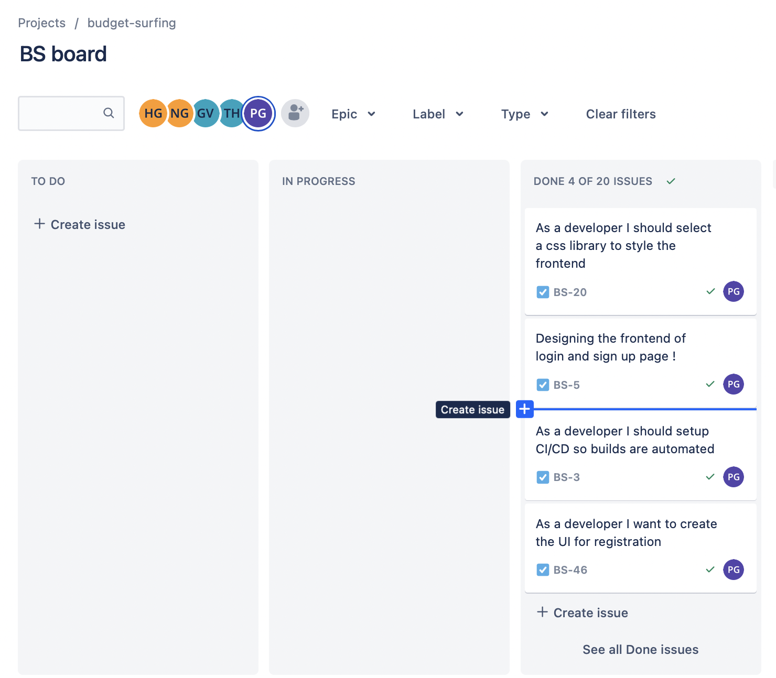
JIRA Board Progress: Parth Gondaliya (B00893694)

Slide 10
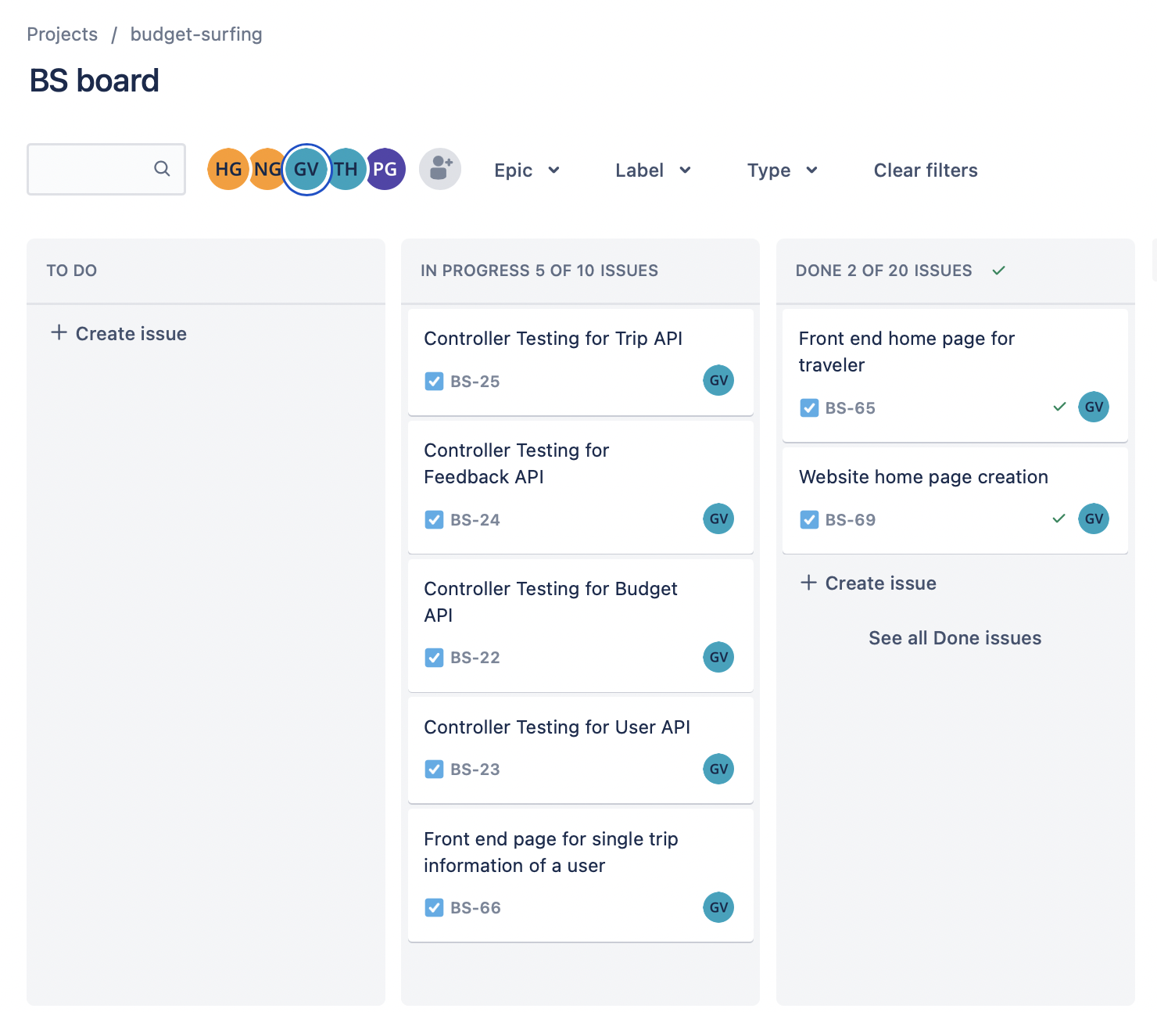
JIRA Board Progress: GRM Vishnu (B00871849)

Slide 11
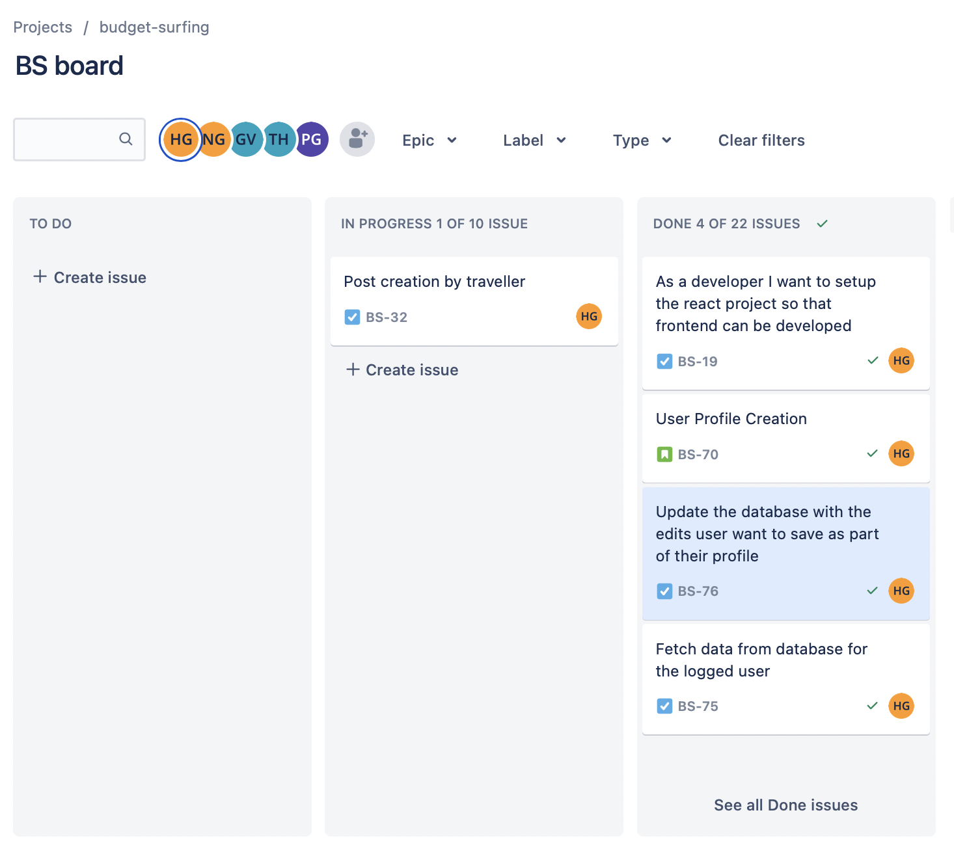
JIRA Board Progress: Hardee Garala (B00869195)

Slide 12

Tech Stack
To develop our project with ease and with best features, we have decided to go with the following tech stack:
Backend – Springboot framework
Frontend – ReactJS

Slide 13
Major Milestones
We have been able to achieve few major milestones along the way till now from where we started, which are:
CI/CD Pipeline
Signup/Login feature
Trip addition feature
Budget setting feature

Slide 14

Demo Video of those milestones
https://drive.google.com/drive/folders/1rPP1sVTzvrcmxdsEdBtW-Mjfz3Ctl8Ht?usp=sharing

Slide 15
Project status w.r.t mid term goals
Mid Term goals | Achieved or not/Reason if not achieved
User registration, Account verification through OTP sent on registered email, Login module | Achieved
Profile creation of users | Achieved
Trip functionality | Achieved
Timely notifications if exceeding budget limits | In progress ()

Slide 16
Other goals
Other goals | Achieved or not
Budget functionality | Achieved

Slide 17
Challenges
Working on Springboot or ReactJS has been a new task for few of the team members since they had to learn it new and fast in order to achieve the goals of the project and so, it has been a bit difficult to kick start the whole project.
But in a short span of time, all the team members showed great achievement in learning their respective requirement and that didn’t affect the project status.

Slide 18
Next Steps
Since every team member contributed equally to both front end and back end, we have planned our way to complete that by working on either one of them until midterm progress and then shift their roles otherwise.
So, the team developers who have worked on front end till now would now shift to back end and the same goes with the back-end developers.

Slide 19

Thank you!

